Slide 1
End Fed Half Wave
Dipole Wire Antenna

Slide 2
Table of Contents
Overview
The EFHW Antenna – the parts
The EFHW Schematic
Simplified Theory of Operation
The Impedance Matching Transformer
Construction of the Impedance Matching Transformer
To Counterpoise or Not
Pros and Cons

Slide 3
Overview

Slide 4
Wanted …
A low cost antenna
Easy to deploy – maybe even portable!
Multi-band

Slide 5
The EFHW Antenna
The Parts

Slide 6
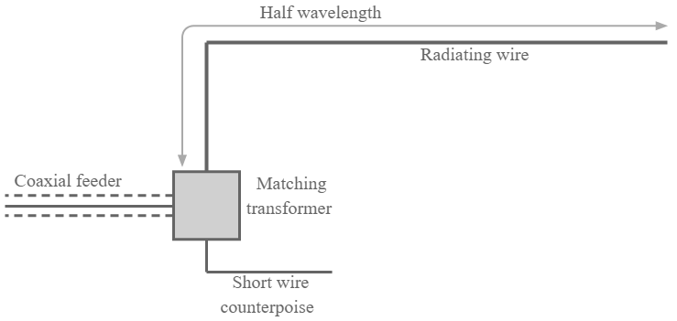

Slide 7
The EFHW Antenna
The Schematic

Slide 9
Simplified Theory of Operation

Slide 10
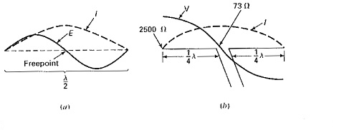

Slide 11
Impedance Matching Transformer

Slide 12
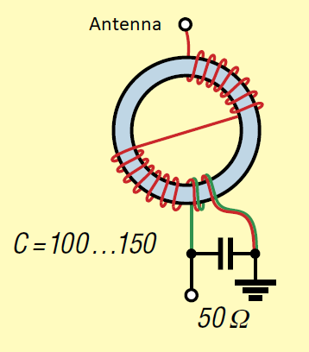
Transformer Ratio | Impedance (ohms)
9:1 | 450
16:1 | 800
25:1 | 1250
36:1 | 1800
49:1 | 2450
64:1 | 3200

Slide 13
Transformer Construction

Slide 15
Pros and Cons

Slide 16
Pros
Multi-band – 40, 20, 15, 10 without tuner. Add 12 and 17 with tuner
Efficient enough for QRP use
Easy to build whether using kit or discrete parts
Works well horizontally, vertically, or sloper
Radiator shape not critical
Low cost
Very portable

Slide 17
Cons
Performance may not be ideal as compared to mono band antennas
High voltages can exist on the ends
A few reports of RF in the shack

Slide 18
References

